Slide 1
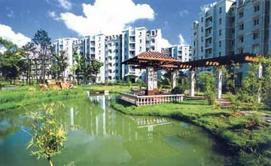
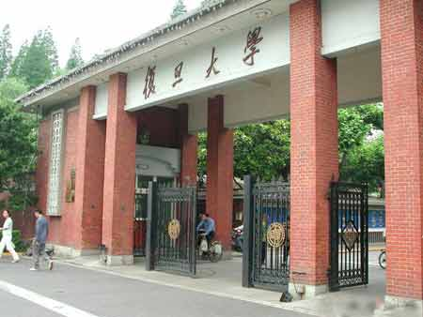
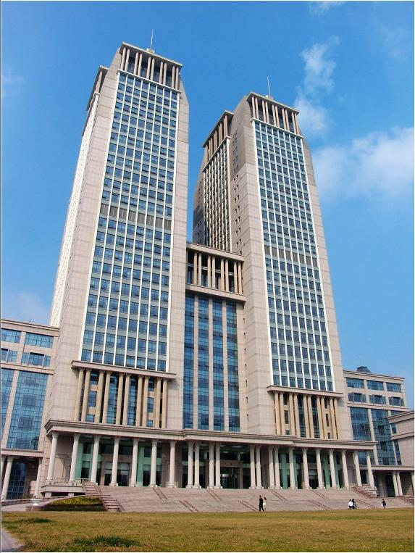
Artificial Intelligence
Xiaoqing Zheng
zhengxq@fudan.edu.cn

Slide 2
Programs vs. Expert systems
Programs
=
Algorithms + Data Structures
Expert Systems
=
Knowledge + Inference

Slide 3
Knowledge representation
• Representation, acquirement and use of knowledge
are three main domain of research and application in
artificial intelligent.
• Knowledge representation serving as a starting point
or basis of the two later.

Slide 4
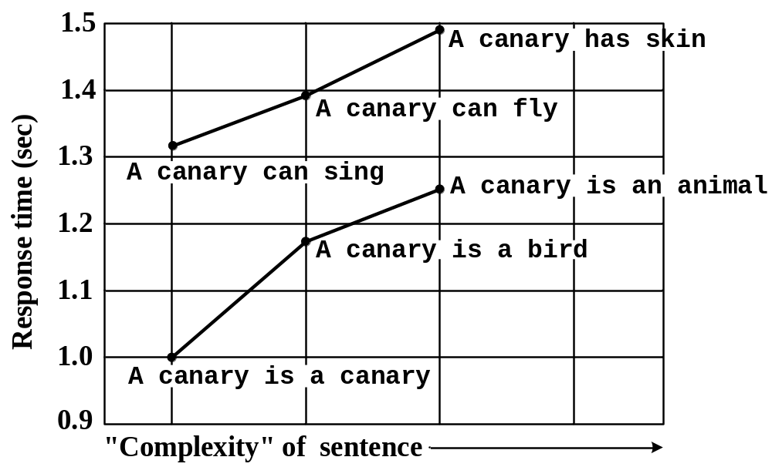
Psychological evidence
Assumed hierarchy that
explains response data
can
Breathe
ANIMAL
has
Skin
can
is-a
Move
is-a
can
Fly
FISH
BIRD
has
Wings
has
Feathers
is-a
is-a
CANARY
OSTRICH
can
is
cannot
is
Sing
Yellow
Fly
Tall

Slide 5
Inference in semantic networks
BIRD
CAN-FLY
property
is-a
color
CANARY
YELLOW
is-a
owns
TWEETY
SYLVESTER
○ CAN-FLY (CANARY)
○ CAN-FLY (TWEETY)
○ SYLVESTER owns Something that can fly
○ TWEETY is YELLOW
○ SYLVESTER owns a CANARY
○ SYLVESTER owns a BIRD
Notes:
To standardize link names even further
优点：易读懂
缺点：无法表示过程知识；当试图用于表示世界知识时，网络结构变得过于复杂
知识图谱

Slide 6
Frame
hotel room
specialization of: room
location: hotel
contains: (hotel chair hotel phone hotel bed)
hotel chair
specialization of: chair
height: 20 – 40 cm
legs: 4
use: sitting
hotel phone
specialization of: phone
use: (calling room service)
billing: through room
hotel bed
superclass: bed
use: sleeping
size: king
part: (mattress frame)
mattress
superclass: cushion
firmness: firm

Slide 7
Types of slot
• Frame identification information.
• Relationship of this frame to other frames.
• Descriptors of requirements for a frame.
• Procedural information.
• Frame default information.
• New instance information.

Slide 8
Inference in frame systems
John like a fire engine.
John
isa: human
gender: male
enterprise: average
activity:
volume:
fire engine
isa: motor vehicle
color: red
activity: high
volume: very high
fuel efficiency: average
ladder: 5m
John
isa: human
gender: male
enterprise: average
activity: high
volume: very high
Notes:
优点: 将当前焦点对象的属性和描述集中显示；可以带有过程知识
缺点: 比较适合表示常识、惯例和套路。

Slide 9
Conceptual graph
bird
flies
Files is a 1-ary relation.
dog
color
brown
Color is a 2-ary relation.
father
child
parents
Parents is a 3-ary relation.
mother

Slide 10
Unique token: maker
dog:#007
color
brown
name
"emma"
A dog name emma is brown.

Slide 11
Generic maker
dog:*X
agent
scratch
object
ear
instrument
part
paw
part
dog:*x
The dog scratches its ear with its paw.

Slide 12
Propositional concept
person:"tom"
experiencer
believe
object
person:"jane"
subject
likes
proposition
pizza
object
Tom believes that Jane likes pizza.
Notes:
可以表示意图、信念、假设、计划、目标
大灰狼与免子的故事

Slide 13
Inference in conceptual graphs
G₁:
agent
eat
object
bone
dog
color
brown
G₂:
animal:"emma"
location
porch
color
brown

Slide 14
Restriction operation
G₃:
dog:"emma"
location
porch
color
brown
The restriction of G₂.

Slide 15
Join operation
G₄:
agent
eat
object
bone
dog:"emma"
location
porch
color
color
brown
The join of G₂ and G₃.

Slide 16
Simplify operation
G₅:
agent
eat
object
bone
dog:"emma"
location
porch
color
brown
The simplify of G₄.

Slide 17
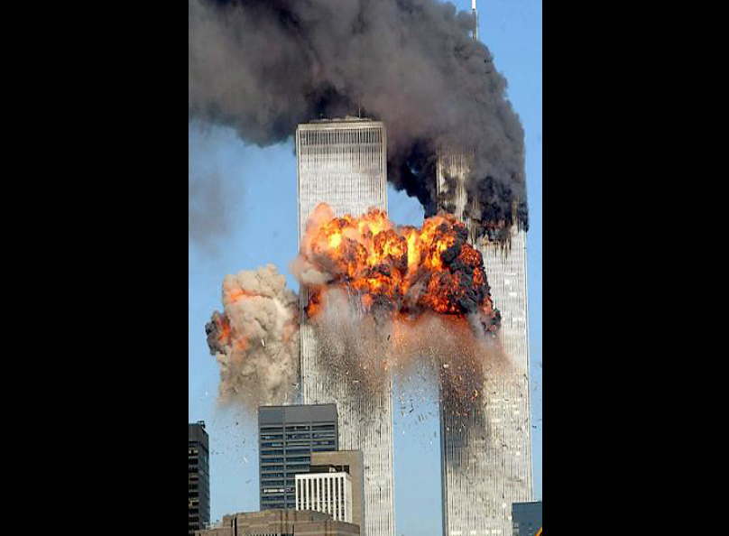
The limits of relational technology
Notes:
在分析关系型数据库缺点，从而不适合大规律数据集成的问题，以及现在有新的什么数据管理模型之前。
数据、计算能力、机器学习方法
我们谈一下大数据的概念和应用。

Slide 18
The limits of relational technology
28 intelligence databases
connected across
17 US intelligence agencies
over 5 years
totally missed …

Slide 19
The limits of relational technology
Relational power rule:
The full power of relational technology applies
to semantically homogeneous relational databases
Databases tend to be mutually semantically heterogeneous hence lack a basis for guarantees for data integration for
Correctness
Efficient design, development, execution
Relational assumptions
• Updatable views
• Global Schema
• Single Version of Truth
Notes:
模式差异：学生数据库，按年、按学院
国际会计准则

Slide 20
Triples in knowledge graph
rdfs:type
Person
https://xxx/sean_penn/
fullName
Sean Penn
mailBox
occupation
sean_penn@xxx.com
Actor
https://xxx/sean_penn rdfs:type Person ;
fullName "Sean Penn" ;
mailbox. "sean_penn@xxx.com" ;
occupation "Actor" .
Notes:
语义网：太过自由。RDF即有语义网易懂，又有相应逻辑系统

Slide 21
SELECT ?author ?titre ?homepage
http://www.amitavghoshe.com
Amitava Ghoshe
foaf: homepage
foaf: name
http://dbpedia.org/resource/amitavghoshe
owl:sameAs
a: name
http://.../isbn/02345X
Amitava Ghoshe
a: author
b: original
merge
http://.../isbn/02345X
http://.../isbn/03676X
a: title
a: price
b: titre
b: prix
owl:equivalentProperty
Life Science
Sciences de la Vie
rdf: value
p: currency
rdf: valeur
b: devises
54
USD
49
EURO
Notes:
为什么RDF好过RL：
图的合并，相当于表的合并
不需要指定数据库的名称和表的名称。
模式的改更困难：改变主键。
分布式管理，没有中心管理者的角色。而关系型数据库需要按中心设计者的意图来实现。

Slide 22
Stages
Input: Tarzan kissed Jane.
Parsing
Parse tree:
sentence
verb phrase
noun phrase
noun phrase
noun
verb
noun
Tarzan
kissed
Jane

Slide 23
Stages
Semantic interpretation
Internal representation:
person: tarzan
person: jane
agent
kiss
object
instrument
lips

Slide 24
Contextual / world knowledge interpretation
Expanded representation:
possess
pet: cheetah
experiencer
love
object
person: tarzan
person: jane
agent
kiss
object
instrument
lips
location
jungle
location

Slide 25
Stages
Question answerer,
Database query hander,
Translator, etc.
Language generator,
Speech synthesis

Slide 26
Others
• Logics: propositional, first-order, description, modal
• Production rule
• Artificial neural network
• Decision table
• Knowledge Petri net
• Script
• Bayesian network
• Object-attribute-value triples
• Neurules
• Language field theory
• ...

Slide 27
Any question?
Xiaoqing Zheng
Fudan University

